Slide 1
Hi
This is my Relativity ISU
By Terry Tong

Slide 2
The Theory of Relativity.

Slide 3
This theory is able to accurately describe how the Macro universe works in essence.
There are two parts to his theory which are General Relativity, and Special Relativity which I will talk about later on. But first lets talk about how it affected Galileo’s relativity and how it was changed by Einstein’s relativity.

Slide 4
Galilean Relativity
Why Galileo was wrong.

Slide 5
Galileo Relativity Rules
absolute time, motion and space as defined in Newton's
lengths or distances are absolute no matter what is the velocity
infinitely many inertial frames of reference, each one in relative motion to absolute space
universal time throughout space where all inertial frames share this universal time
all laws of physics are the same in all inertial frames of reference whether at rest or in motion relative to absolute space
speed of light is instantaneous ( information transmission is instantaneous )
all possibilities of unbounded, relative motion
Newton's Law of Universal Gravitation holds as derived from Newton's "Axioms, or Laws of Motion"
inertial frames of reference are related by Galilean rules of transformation - i.e., simple vector addition and subtraction

Slide 6
Galileo explained relativity first using a cannon ball being dropped from the top of a mast, and there are two observers. One observer is moving constantly with the ship, while the second observer is staying stationary on the land.

Slide 7
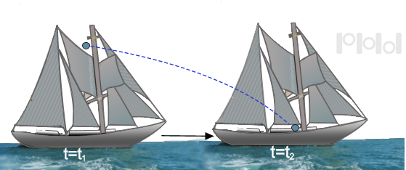
As seen, this is from a stationary observer, we see that the ball is moving from one location to the other. But if it was from the second observer who is moving constant velocity with the ship, they would see that the ball dropped straight down.

Slide 8
What Einstein said
How he flipped the table on its side

Slide 9
Einstein’s Relativity
no absolute time, motion or space, rather ( space - time ) space-time
lengths contract at velocities approaching c relative to stationary observers.
infinitely many inertial frames of reference, each one in relative motion to each other
each inertial frame has its own time dilation
all laws of physics are the same in all inertial frames of reference which leads to the invariance of the speed of light, c
speed of light is finite ( information is finite transmitted )
all possibilities of unbounded, relative motion with upper limit of velocities of bodies and particles held at c, speed of light
Newton's Law of Universal Gravitation is only true as an approximation of physical reality for relative velocities v << c
inertial frames of reference are related by FitzGerald - Lorentz Transformation rules

Slide 10
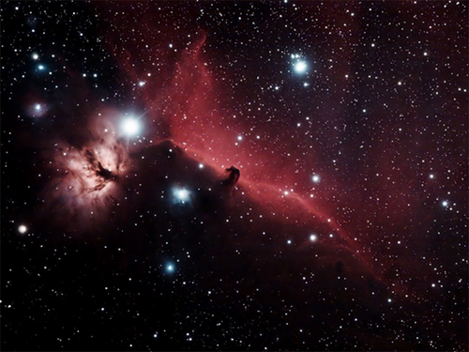
Events that happen in the universe that are separated by a distance there events might appear simultaneous to you but may appear in different times for an other observer. As Everything is only relative to each other, it is impossible for an event to be simutanous.
We see the past when we look at the stars, as light takes time to reach us.

Slide 11
General Relativity.
Einstein's way of clarifying gravity and its effects on time and space.

Slide 12
What is so general about it?
Einstein talks about space and time as being connected in to a plane that spans the whole universe. And that this plane is very much so like a flexible fabric that bends and distorts when there are objects on it. This theory provided a great insight to objects moving within a non inertial frame of reference.

Slide 13
Question: If you where moving at 30 km/h and you threw a ball towards the direction of movement at 20 km/h, what would the ball’s speed be?
20 km/h
50 km/h
Not enough information to know

Slide 14
Answer is not enough Information is given.

Slide 15
Why is that? Was my math wrong some how?
Both of the numerical answers given would have been correct, but they must be given to a reference to an object or a “frame of reference” in order to be valid. And As Einstein has said that when we are dealing with velocities that are only very tiny compared to light, the velocity additions are kept to their sums.
Going 20 km/h relative to the thrower ✓
Going at 50 km/h relative to the ground ✓

Slide 16
Question: If you shined a flash light while aboard the enterprise space ship traveling at 70% of C and shined a flash light towards the incoming space would the speed of the light be seen traveling at C+(0.7xC )?
*C = 3.00x10⁸ meters per second
Yes
No
Trying to trick me again aren’t you

Slide 17
Answer is no

Slide 18
No? Impossible you just told me that the speed is relative, so an observer would see the beam traveling at C” 0.7xC
While if you where traveling very close to the speed of light, and you fired a missile, a stationary observer would see that missile go slower than expected of the velocity sum, as this is explained through Einstein’s velocity addition formula on slide 53. But if you shone light, the light traveling relative to the observer is the same speed as someone that is stationary. This is all explained within time dilation and length contraction because of how Einstein stated that light has an absolute speed. So if observers must agree on the same speed of light, then they must disagree on the time and distance.

Slide 19
Inertial vs. Non-inertial F.O.R
BTW. F.O.R stands for Frame of reference

Slide 20
F.O.R a general explanation
BTW. Again F.O.R stands for Frame of reference

Slide 21
F.O.R noun /ef-oh-ahr/
A frame of reference is what the word means, it is what you are going to refer to for the measurements you are taking.
Example: a car is measures its speed relative to the ground so therefore the earth is it’s F.O.R .
capisci? no? okay?

Slide 22
Inertial F.O.R
Inertial adjective /iˈnərSHəl/
Word derives from inertia, so what is inertia it’s a property of matter when it is either in a state of rest or constant motion.

Slide 23
Speed testing 101
For an inertial FOR, we are considering the FOR of anything that is moving at either constant velocity or something that is stationary. For instance earth is rotating at a constant velocity therefore we do not feel the earth rotating. As long as everything you are measuring are in the same inertial frame all laws of physics holds true.
For example if you where to measure the speed of a plane from a stationary perspective you would get its speed relative to the inertial frame that is of the earth.

Slide 24
Question: Is there an absolute inertial frame of reference?
Yes
No
What?

Slide 25
The answer is no
But you already knew that didn’t you?

Slide 26
Why isn’t there a absolute frame of reference in which we can have an universal reference?
We cannot have an absolute frame of reference in the universe because we are all relative to each other, as we all are moving. The earth is moving relative to the sun, while the sun is moving relative to the milky way, while the milky way is moving relative to other galaxies at light speed. Thus we cannot establish one region of space where there is absolutely no movement.

Slide 27
No experiment you can do, to prove that you are either standing still or in constant velocity
Einstein stated that it is physically impossible to determine whether you are actually moving at constant velocity or staying stationary. As the two is clearly pointed out if you where sitting on a train with the blinds closed and where asked are we moving?. Your first reaction is to look out the window, but if you didn’t look out the window there is no way you can prove whether you are or not moving on the smooth tracks.

Slide 28
Non-inertial F.O.R
For those that are moving.

Slide 29
A short Description.
This time instead of a nice uniform speed ride, our ride is going to be accelerating, turning side to side, and going up and down bumps. Then within this situation how are you going to get a reading for any measurement if there are external forces at work? As if you are in an non-inertial F.O.R there are going to be external forces that will alter your measurements (fictitious forces)

Slide 30
Special Relativity
Special Relativity noun /spesh’el/
A version of relativity in which it is special in a way. In which I joke.

Slide 31
So what’s so special?
Einstein’s special relativity explains within the special theory of relativity in which time and space are tied together in the absence of gravity. And that this theory postulates everything in the universe sees light traveling the same seed independent of the F.O.R.

Slide 32
Jim buys a sports car with his friend John.

Slide 33
Jim measures the sports car on the tarmac with a ruler.
The car is not moving.

Slide 34
While John will measure the cars length by letting the car getting to constant velocity and start measuring time from the front of the car, and finish when the back of the car passes the finish line.
So he measures the time elapsed then by dividing the time elapsed by the constant velocity he will get the car’s length.

Slide 35
They both have a cesium atomic clock that are synchronized
Highly unlikely, but we should imagine.

Slide 36
Question: If Jim records his length, and then drives down the tarmac at 200 km/h down the tarmac, what is the length of the car that John will measure?
Johns length > Jims length
Johns length < Jims length
Johns length = Jims length

Slide 37
Answer is Johns length is < Jims length
How is that possible?

Slide 38
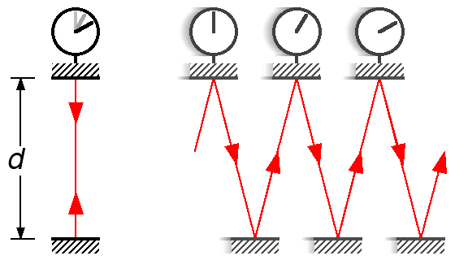
Within special relativity, time slows down for a moving object while being observed from a stationary F.O.R, which is to say how could this be? Lets take the difference between two photon clocks, one stationary and one moving. You can see from a stationary F.O.R you perceive that the light beam takes longer to get from one end to the other while moving compared to the stationary clock. You see the light beam going at a angle to its next frame in time. This is called time dilation in which time slows down for a moving object while being observed from a stationary observer. And there is always length contraction but this will talk about it later.
Stationary
Constant Velocity

Slide 39
A muon radioactively decays in 2 millionth of a second
Muon noun /ˈmyü-ˌän/ an elementary particle that is similar to an electron

Slide 40
If we accelerate one muon to approximately 99.5% of C, by a factor of long do you think before it decays compared to the stationary muon?
2x
5x
10x

Slide 41
Answer is actually 10x
This have been proven experimentally.

Slide 42
Again time dilation is shown within this experiment, as the muon who traveled very close to the speed of light did have a greater life span than of a stationary muon. But this does not mean muon got an extension on its life, in fact for us we see him moving as incredible slow through the passage of time. So if a stationary muon can read 100 books in its life time, an moving muon can only really 100 books also. So if it was a human on hard he/she would experience no life extension, except that the life he is living on board a ship traveling at C is going to be going at a slower pace than of someone that is on the earth.

Slide 43
Length Contraction
Your meter is like a 50cm compared to my meter stick.

Slide 44
Lets talk about Jim and John about the length of his car again.
The length of Jim’s car while traveling at 10% of C would be significantly shorter than at rest why would this be?

Slide 45
This again is a reason in which the special theory of relativity explains that a moving object is shortened along the direction of movement. This is due to one of the postulates that Einstein has proven which is that light is constant no matter how fast you are going, since time dilation only proves some part of how come C is constant for every one, length contraction is the second part to that answer. Speed is measured in meters per second, the meters unit and the time unit both must have a limiting factor in order to have two observer agree upon the speed of light. With the fact that the length is relative to each observer, different observers see different length and this is seen in the equation here. $L=L_{O}\sqrt{1−\frac{v^{2}}{c^{2}}}$ as seen the length does not contract much when speed is small because of the big C value but will contract along as it approaches C.

Slide 46
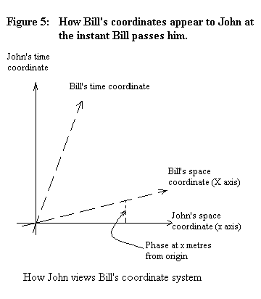
Graph between space and time
If we use a graph that measured space on the x- axis and time on the y-axis, and the terminal arm, is the speed of light. If we where standing still, we would be traveling at the full speed of time and no speed in space. While if we where to approach the speed of light we should not be making any progress through time but very far in space, as you see the component of the terminal arm represents the two relationships.
This graph shows how if you where to be moving through space, your time would seem shorter because of a component that appears, while if you where at rest you would be going no where in space.
X axis is space
Y axis is time

Slide 47
$$e=mc^{2}$$
The mass energy equivalence, as stated that the energy is equal to mass times the speed of light squared(but I am just telling you what you already see) , this shows the clear relationship of how energy and mass is a convertible currency. Which this type of currency was used to convey the atomic bombs which used very little mass and turned it in to a lot of energy. The reason between mass and speed of light equivalence, is that because time and distance measured are only relative, momentum and velocity are only relative as well.

Slide 48
Connections to String theory
Unifying the macro and micro universes.

Slide 49
Lets talk micro, like sub-plank length micro.
When we observe the universe of the tiny, as in smaller than the atoms, the universe at that level of matter is so strange and chaotic it is baffling to scientists, and can be accurately described by quantum mechanics.

Slide 50
Now lets talk about the macro universe, stars, galaxies, and nebulas
Within our macro universe which encompasses all huge bodies of masses in our universe, Einstein's theories all work in these circumstances of objects lying on a fabric of space and time.

Slide 51
Now why a unified theory?
Example: Black holes

Slide 52
Black holes?
The remnants of the death of a star is a black hole. A star in which implodes so quickly that all its mass is condensed in to a single point that is said to have such a huge mass, its gravitational field is so strong light cannot escape from it. The need for a unified theory can be seen here as a black hole is so small to use quantum mechanics or explain it using relativity because it is also so big? The two types of science simply do not mix in order to explain such anomalies.

Slide 53
The quantum plane vs. the fabric of space and time
For example if you where to take a plane ride up in to the sky and look down at the oceans beneath you, you would see it nice and even and flat. In mean time a friend down below riding a boat takes a picture of the water and sends it up to you, and the picture shows typhoon waves and the rough ocean. This is very much like the comparison between the quantum plane and the fabrics of space and time. The surface of space and time is smooth, but when you zoom in to sub-plank levels the surface of the quantum plane is very chaotic and unpredictable.

Slide 54
Strings
String theory states that the basic components of matter broken down further than quarks are strings. Tiny one dimensional strings that vibrate to different resonance frequency, which then would correspond to different energy levels. And these strings are said to be able to explain all forces such as quantum gravity, strong and weak nuclear forces, and even gravity at the smallest scale to gravity at the universe level.

Slide 55
The missing pictures
This presentation is really texty so here are the pictures I should have posted.

Slide 56
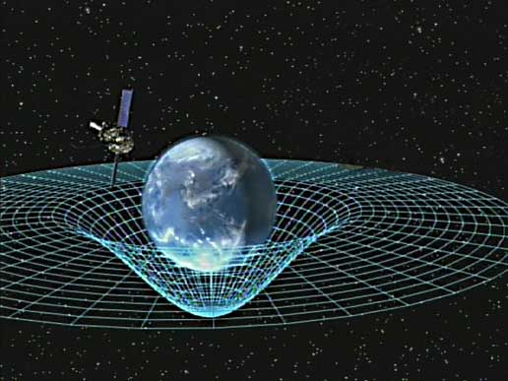
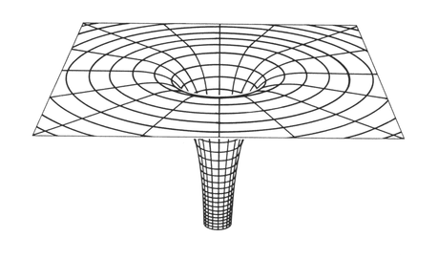
Artist impression of the fabrics of space and time as what Einstein described in his theory of relativity.
A black hole, simulated by a computer, as seen the fabric of space and time is completely disrupted and folded in to a almost vertical well like shape. In which the mass is so heavy we can use Relativity to explain what happens, but yet the mass is also so tiny which can be explained using quantum theory.

Slide 57
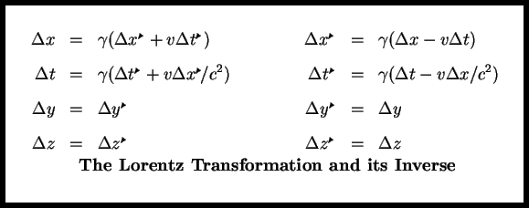
Lorentz is a physicist who created these equation which accurately describes the position and the length of an object when they are approaching light speed.

Slide 58
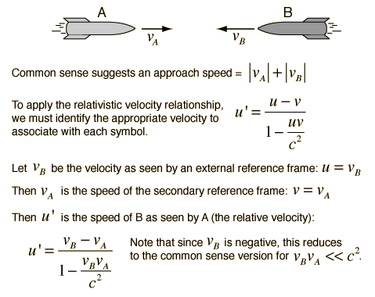

Slide 59
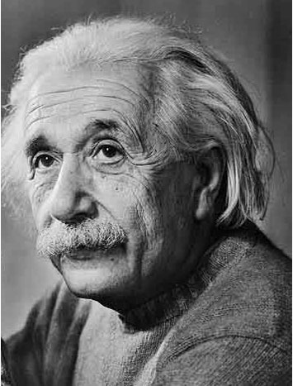
Albert Einstein the man who redefined how we view the universe.

Slide 60
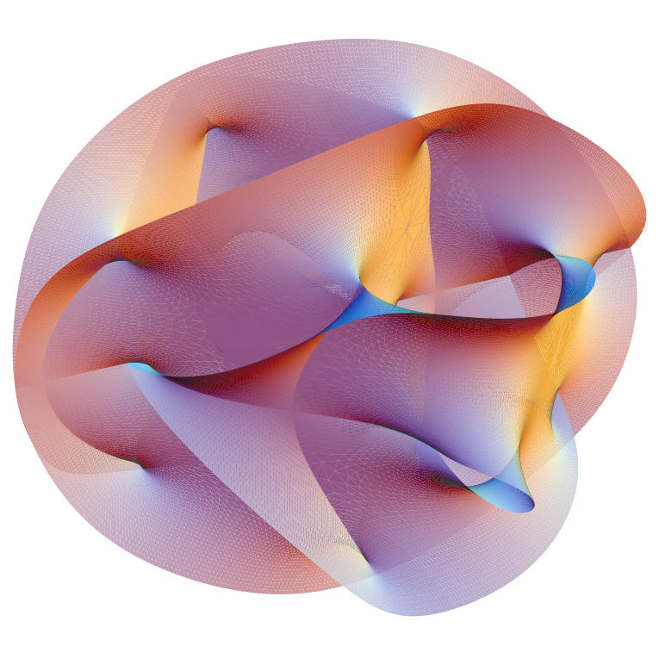
What a multi dimensional string looks like through computer rendering.

Slide 61
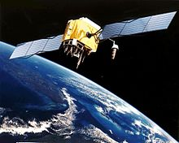
Theory of relativity is used to correct for time dilation within instruments that require very accurate timing, such as GPS. And uses are in cyclotrons and linear accelerators .

Slide 62
Bibliography & Further Readings
End of the slide show basically.

Slide 63
Bibliography Books
Greene, B. The Elegant Universe: Superstrings, Hidden Dimensions, and the Quest for the Ultimate Theory. New York: W.W. Norton, 1999. Print.
Hirsch, Alan J. Nelson Physics 12. Toronto: Nelson Thomson Learning, 2003. Print.

Slide 64
Bibliography Websites
"HyperPhysics Concepts." Hyper Physics Relativity. Web. 07 Jan. 2012. <http://hyperphysics.phy-astr.gsu.edu/hbase/Relativ/relcon.html>.
"A Layman's Explanation for String Theory?" Zidbits - Learn Something New Every Day! 6 Mar. 2011. Web. 07 Jan. 2012. <http://zidbits.com/2011/03/a-laymans-explanation-for-string-theory/>.
Seligman, Courtney. "Inertial and Non-Inertial Reference Frames." Courtney Seligman, Professor of Astronomy. ErindalePublishing.com. Web. 07 Jan. 2012. <http://cseligman.com/text/physics/inertial.htm>.
"Spacetime Continuum - Einstein's Relativity, Space, Time, Quantum Gravity, and Quantum Physics." Love - In Search of a Reason for Living. Web. 07 Jan. 2012. <http://www.ws5.com/spacetime/>.

Slide 65
Further Readings
The elegant universe (within bib)
A layman’s explanation to string theory(within bib)
http://www.youtube.com/watch?v=xvZfx7iwq94 Science TV’s youtube video about relativity.

